Slide 1

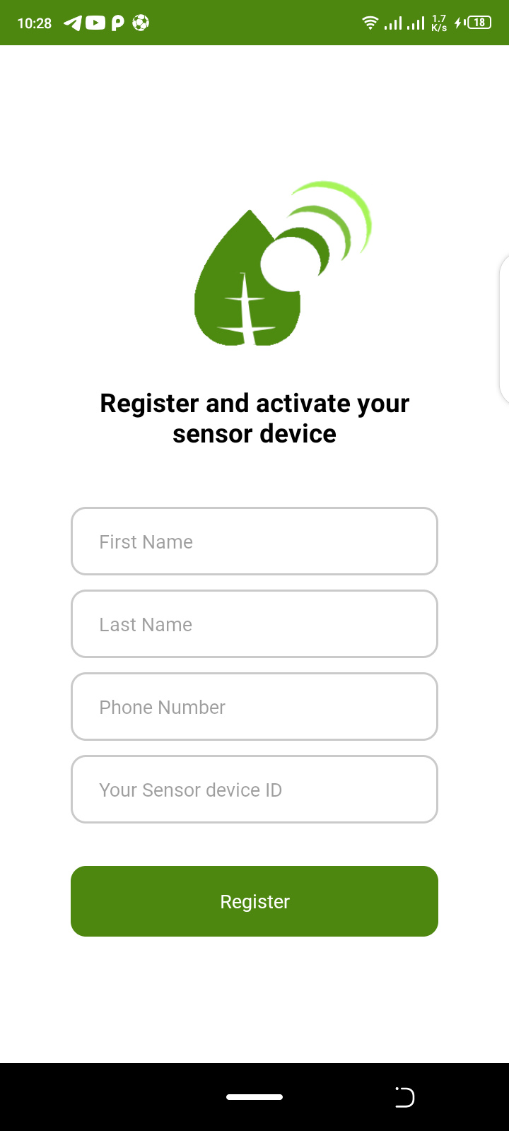
DATAVOC Mobile App
In figure 2 shows a registraiton form to register user on the android phone with the Sniffer ID
User Registers on the mobile phone they will be recieving DATAVOC updates from.
figure 1 : App splash screen.
figure 2 : egister user and sniffer device.

Slide 2
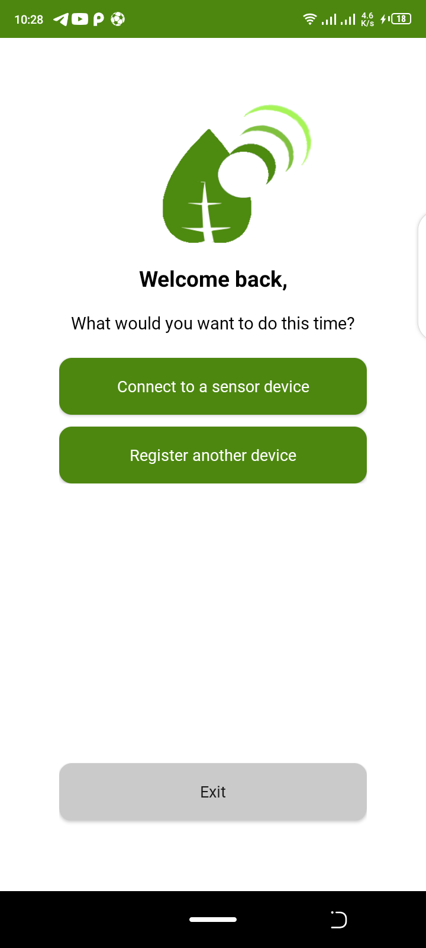
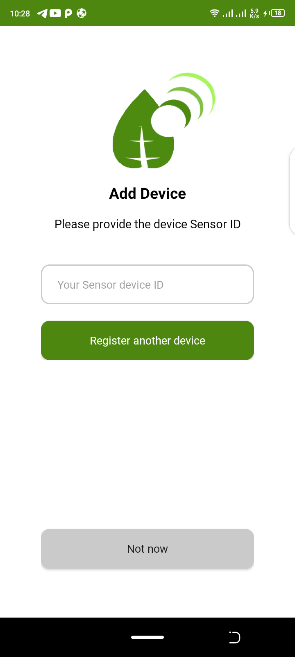
Figure 3 shows the mobile app welcome screen after registration, the user is able to connect to the existing registered sniffer devices or register a new device that he/she will be receiving updates from.
Figure 4 shows the sniffer device registration form, where user is supposed to enter a unique device ID, the phone does not allow duplicate sniffer device IDs.
figure 3 : Mobile app welcome screen.
figure 4 : New sniffer device registration.

Slide 3
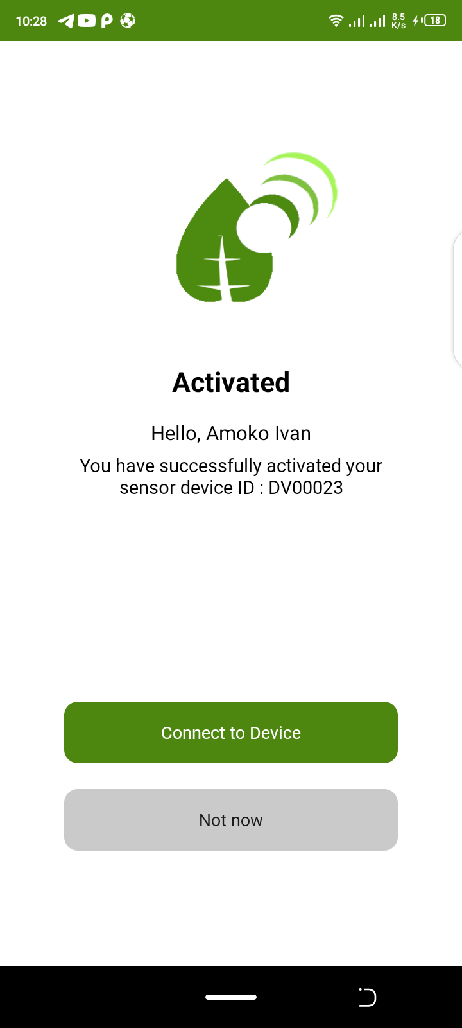
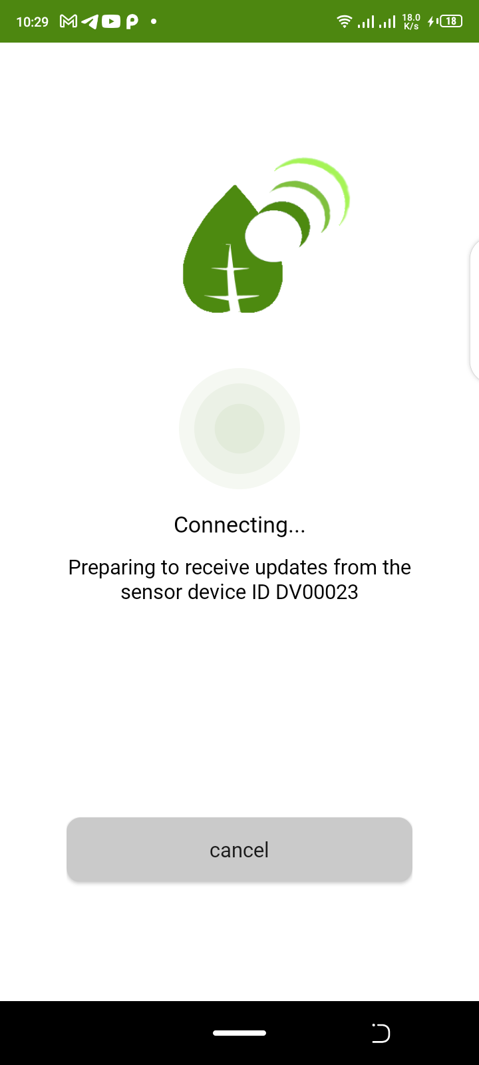
In Figure 5, the sniffer device details are saved and used in establishing connection to the web server.
In figure 6, the mobile phone attempts to extablish a connection to the web server so as to retrieve data updates from the Sniffer device via the network.
figure 5 : sniffer device activated .
figure 6 : Phone attempting connection with the webserver

Slide 4
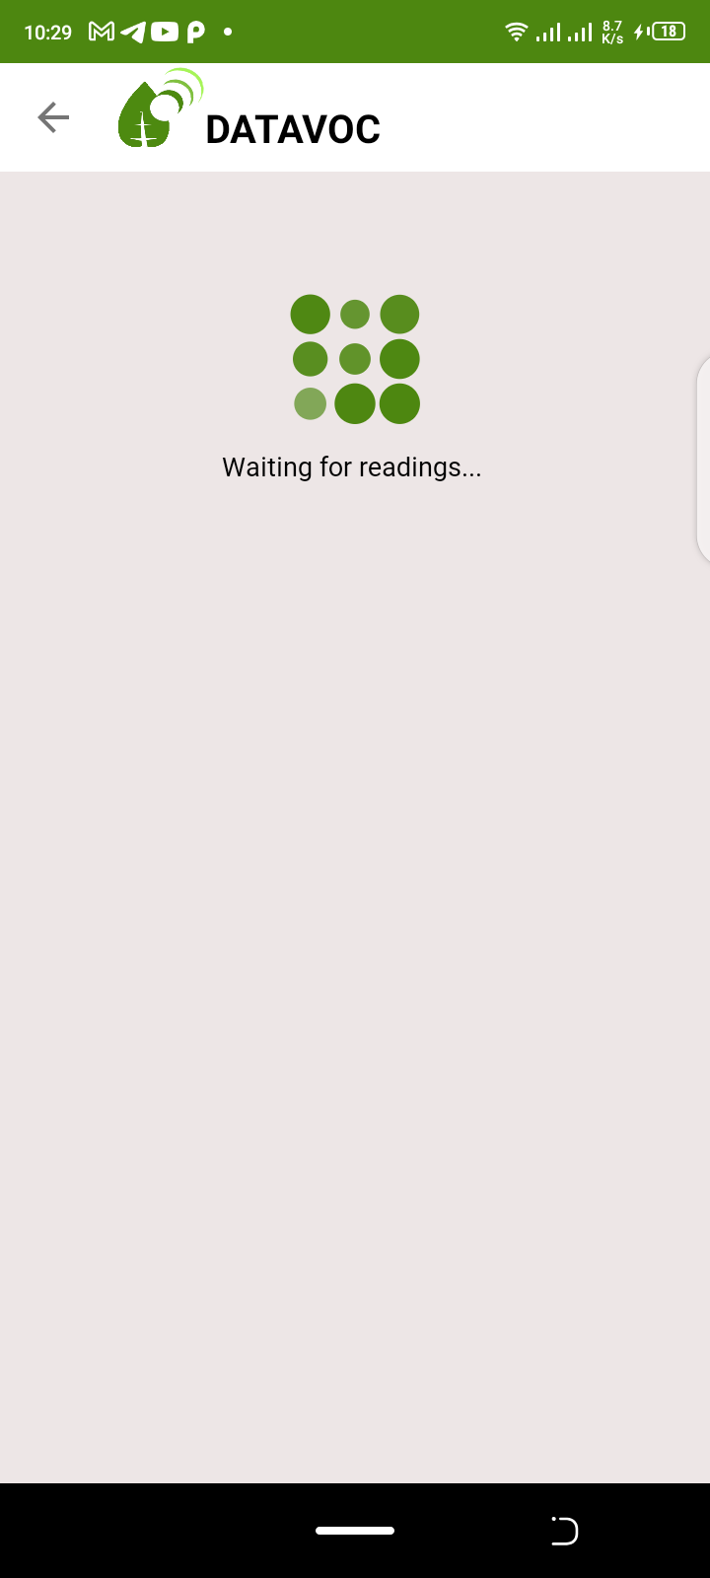
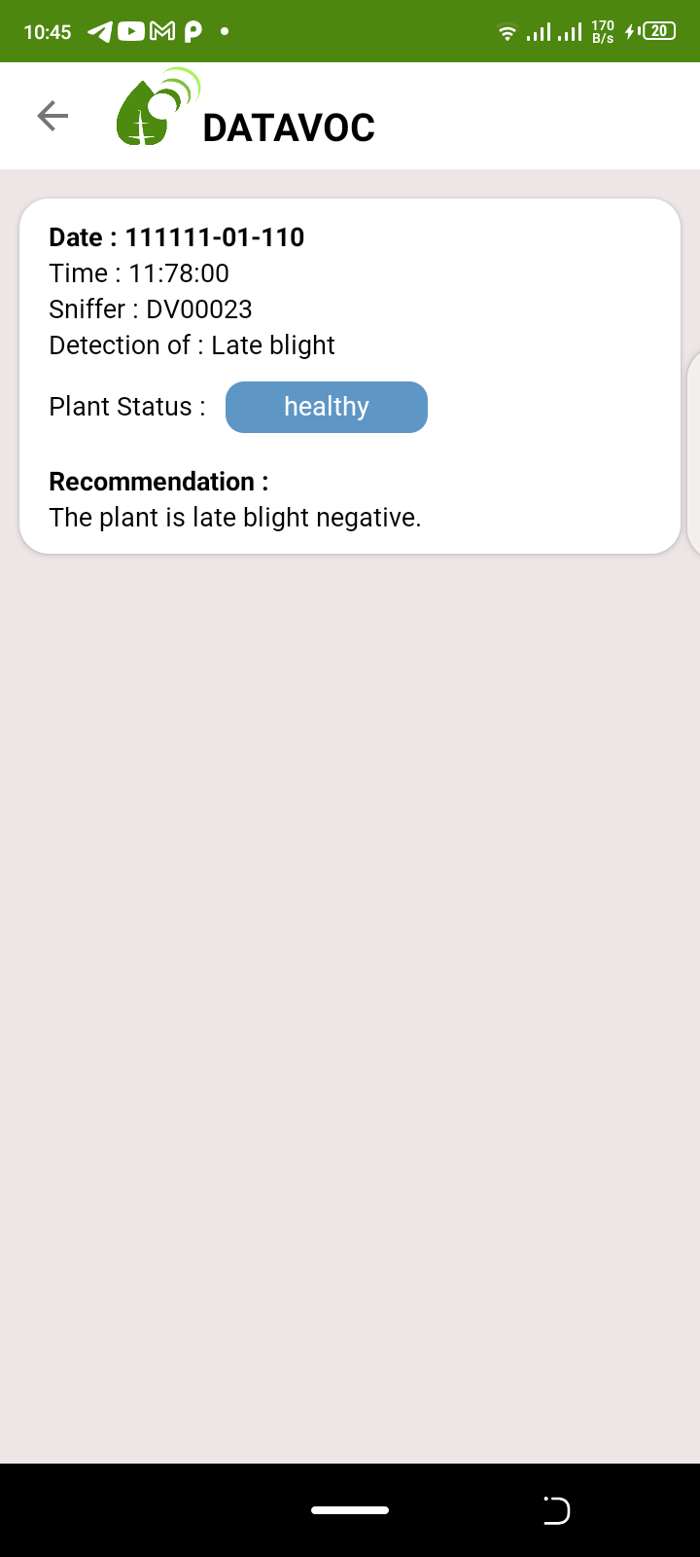
In figure 7, the mobile phone listens for incoming data from the webserver that the sniffer device interracts with, these updates are recieved in real-time.
In figure 8, updates have been received and displayed for the user.
These details include the;
Timestamp in which the sniffer device received readings before processing,
The Sniffer device from which these updates are being got from.
The disease being detected in the plant scanned.
The plant status based of the disease being detected including the level of infection incase its there.
The recommendation, summarized information about the necessary precautions to be taken so as to reduce or totally eradicated the infection at that time.
figure 7 : Mobile phone waiting for snifer device updates from the webserver
figure 8 : Updates recieved from the webserver

